Slide 1
MENTAL HEALTH AND CLIMATE CHANGE
Susan Clayton
The College of Wooster
Climate Health Summit, 20 September 2015

Slide 2
Why look at the effects of climate change on mental health?

Slide 3
Understanding impacts is critical to preparing for them (on a community level)
Describing the impacts can improve understanding of climate change
Health impacts can personalize the issue and transcend the partisan divide

Slide 4
How could climate change affect mental well-being?

Slide 5
The multi-level impacts of climate change
Direct and indirect effects
Acute and gradual changes
Experience and perception

Slide 6
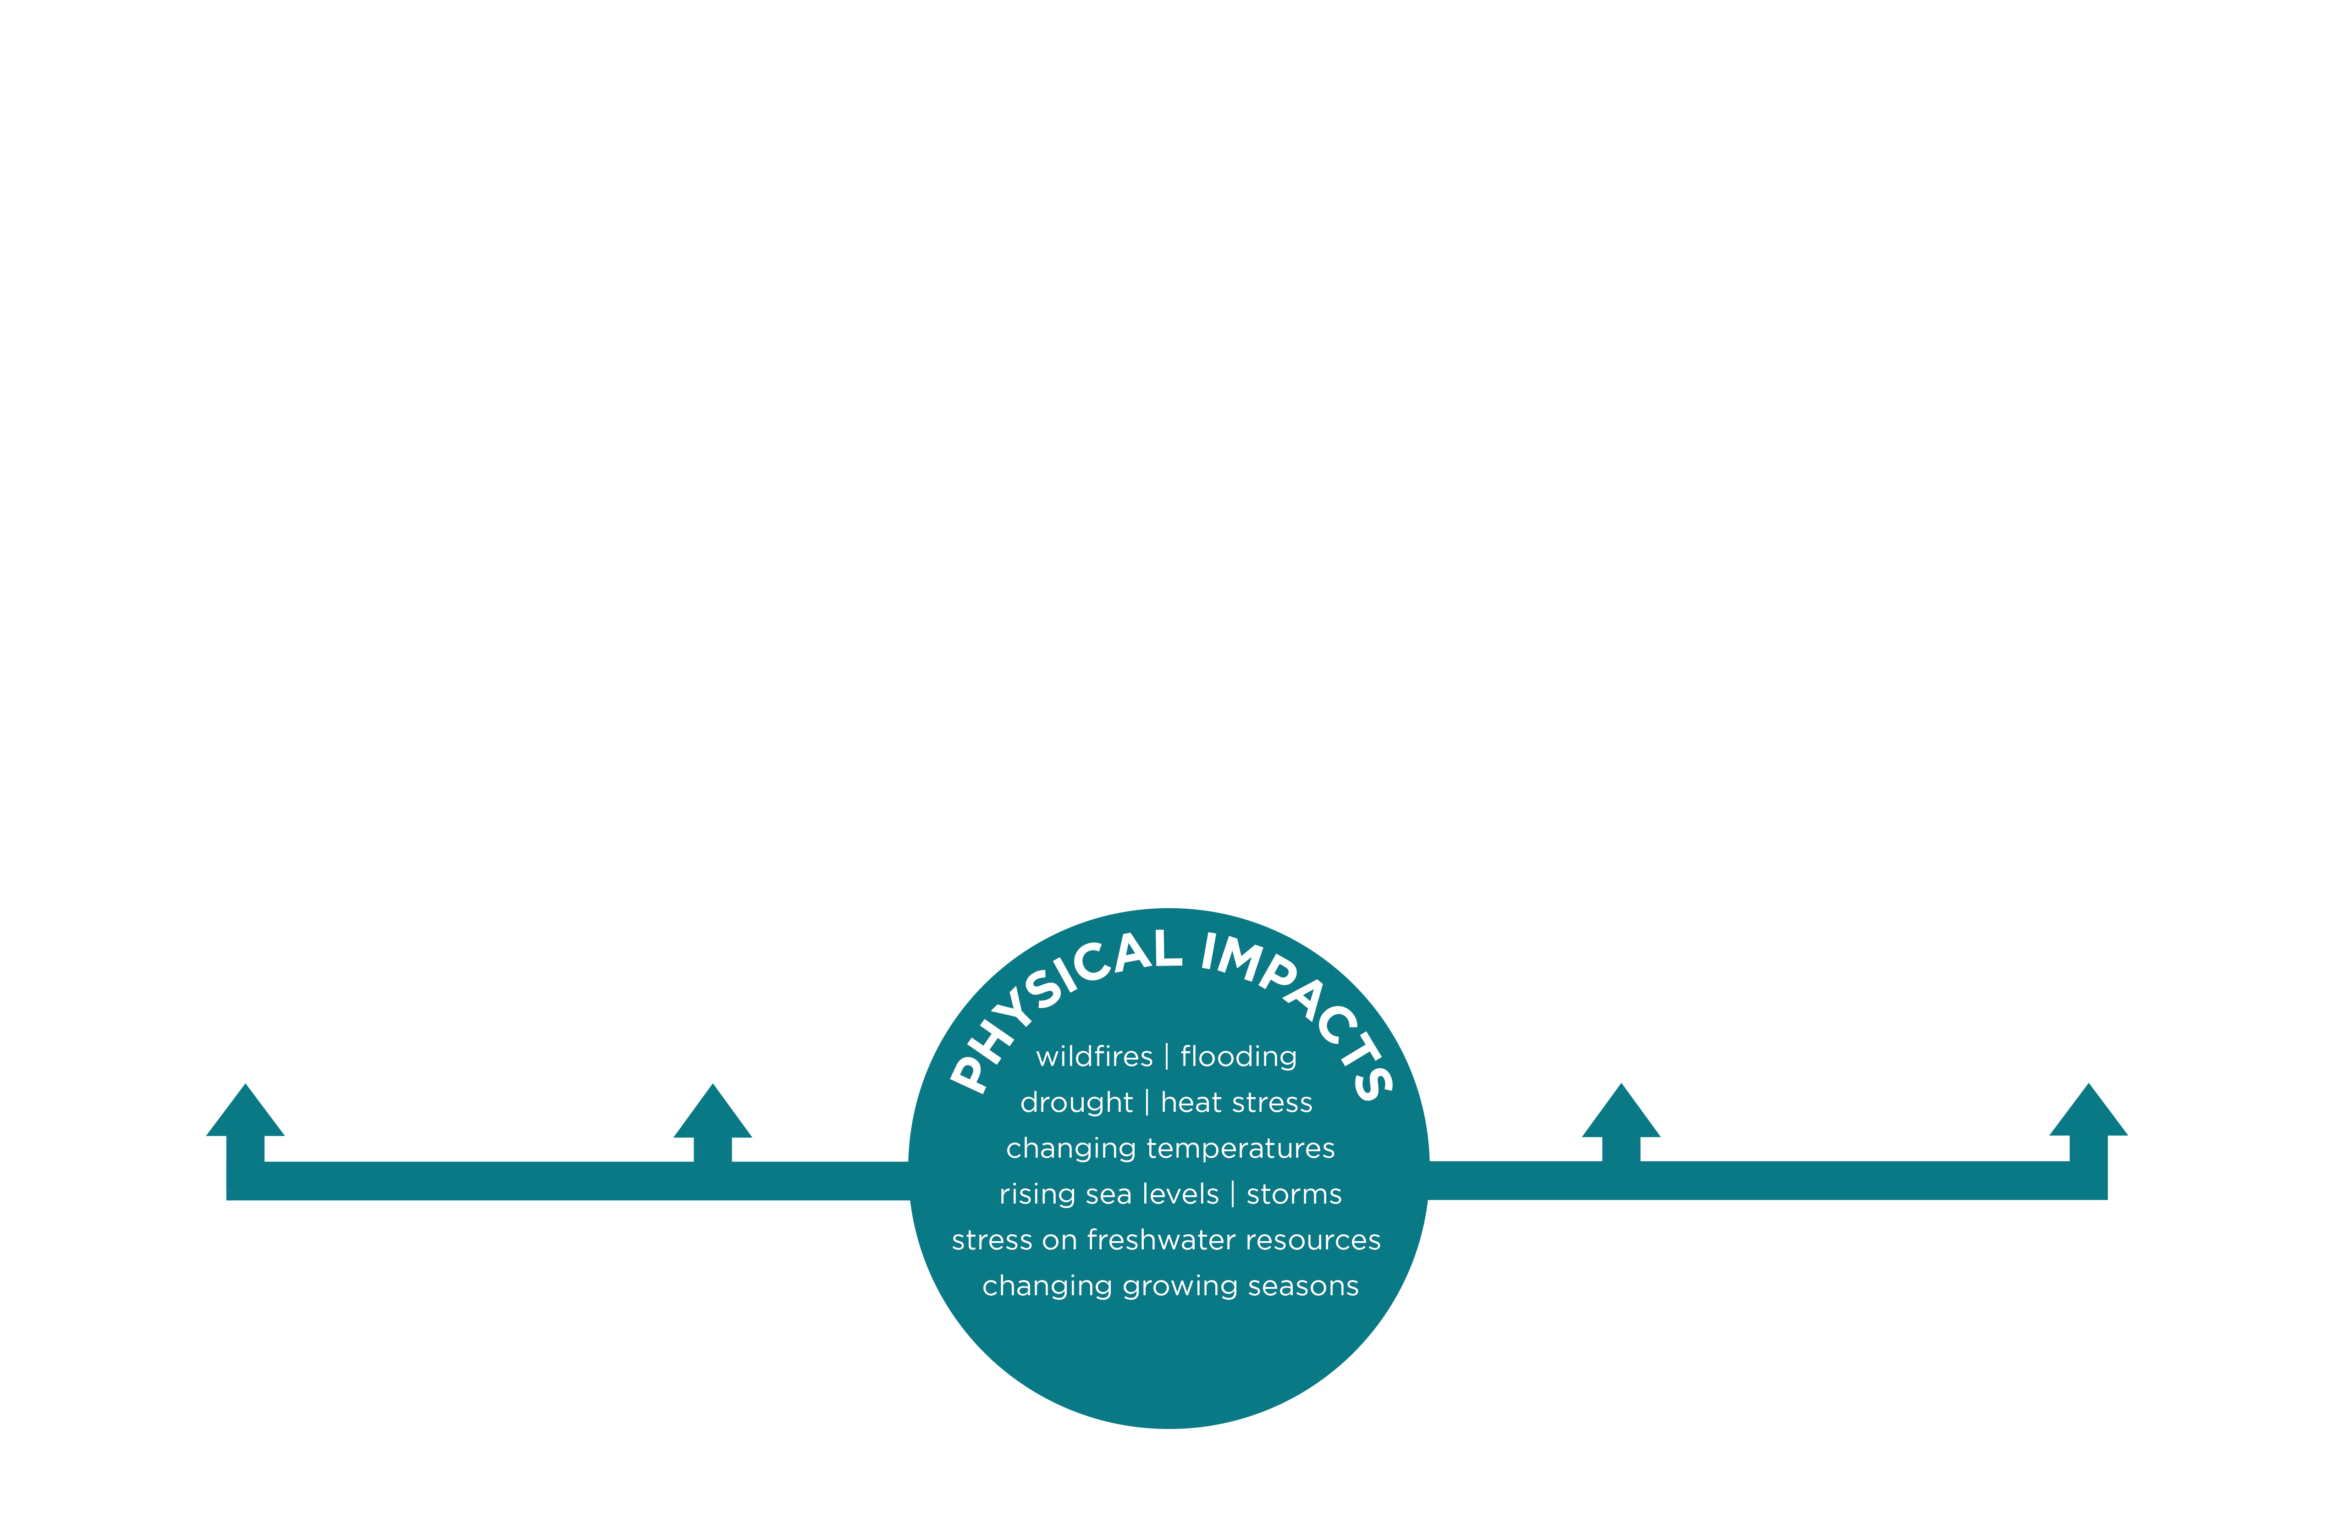
Source:
EcoAmerica
http://ecoamerica.org/research/#PsychImpacts

Slide 7
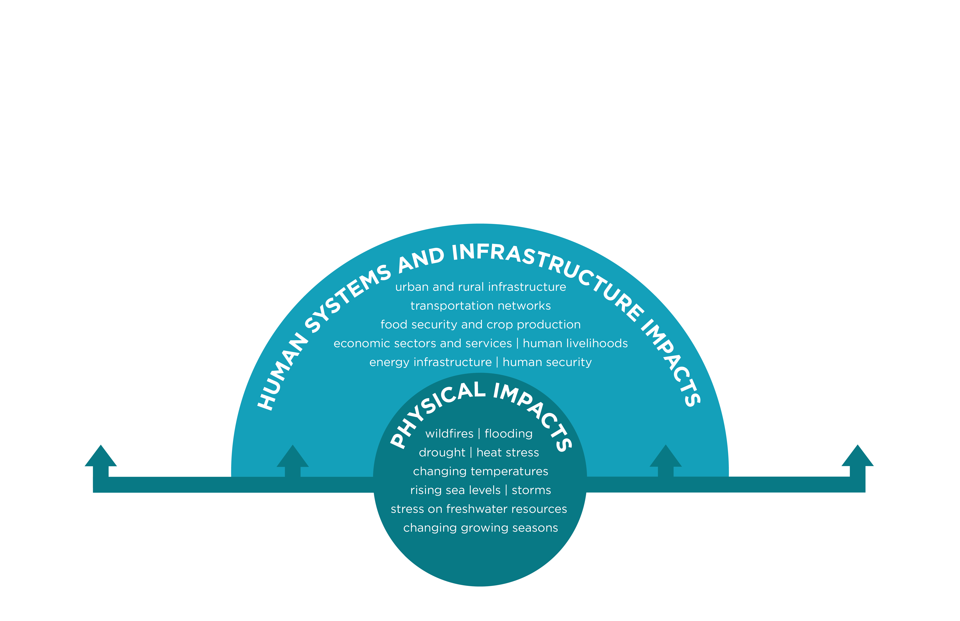
Source:
EcoAmerica
http://ecoamerica.org/research/#PsychImpacts

Slide 8
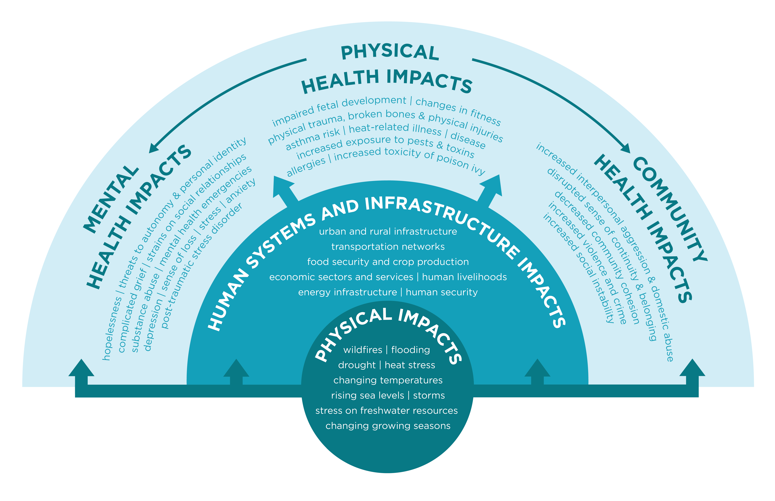
Source:
EcoAmerica
http://ecoamerica.org/research/#PsychImpacts

Slide 9
Direct effects
PTSD
Depression
Domestic abuse
General anxiety
Suicide and suicidal ideation
“Complicated grief”
Substance abuse
-- may last several years or longer

Slide 10
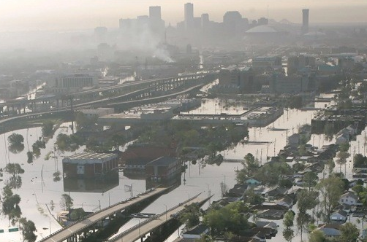
E.g., effects of Hurricane Katrina
49% developed an anxiety or mood disorder
1 in 6 developed posttraumatic stress disorder

Slide 11
Indirect effects
Due to economic difficulties,
Damage to physical and social infrastructure,
Environmental degradation,
All possibly requiring migration

Slide 12
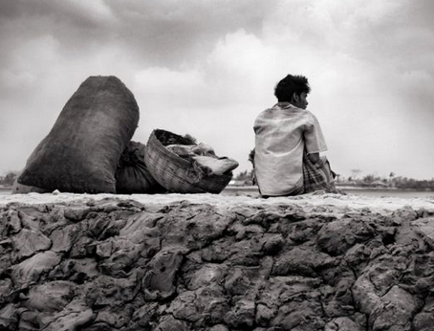
Indirect effects
Natural disasters in 2014 cost $25 billion in the US (this includes earthquakes) and $110 billion worldwide
Natural disasters in 2014 displaced 19 million people worldwise

Slide 13
Broad implications
Diminished sense of self
loss of place and disruption of place bonds
loss of occupation
loss of lifestyle and culture
Lowered autonomy
Reduced social cohesion
weakened social ties
increased conflict

Slide 14
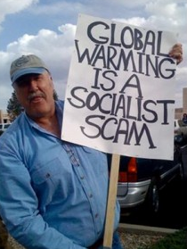
Uncertainty about climate change
Individual responses
lack of control,
anxiety about unpredictability
Intergroup tensions
over meaning
due to perceived inequity

Slide 15
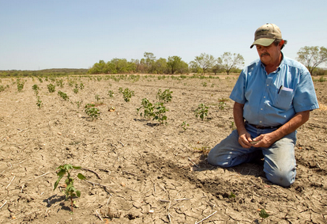
Effects of anxiety about the future
Stress
Hopelessness

Slide 16
Who will be affected?

Slide 17
Not everyone will be affected equally
At greater risk:
Women, children, members of marginalized communities
Those already suffering from mental illness

Slide 18
HOW are children vulnerable?
Physical vulnerability:
Immaturity can enhance the risk of disease, impact of persistent stress, and effects of malnutrition.
Stress itself, along with malnutrition and lack of clean water, makes the body more vulnerable.

Slide 19
HOW are children vulnerable?
Social vulnerability:
Disruption to education
Psychological vulnerability:
Dependence on others
Need for security
Effects will depend on the child’s developmental stage as well as sources of resilience.

Slide 20
What can be done? Promoting resilience

Slide 21
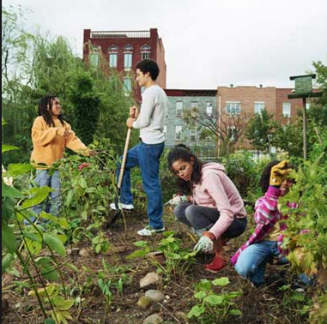
Factors associated with resilience
Practical support
Community ties
Sense of optimism
Notes:
Coming together as a community can actually strengthen social ties and provide an occasion for personal growth.

Slide 22
Plan ahead
Establish the infrastructure to encourage adaptation
Strengthen social networks
Provide resources to cope with disasters, including informational resources and mental health support
Educate
Encourage optimism and sense of efficacy

Slide 23
Mental health is not just the absence of mental disorder!
Climate change presents an opportunity
to examine the social and physical infrastructure of our communities
to consider opportunities of enhancing well-being

Slide 24
More You Can Do
Communicate about the health effects of climate change
Get involved in disaster preparedness efforts
Health practitioners: do more research, and incorporate into practices
Coordinate and support with others involved in addressing climate change

Slide 25
Thank you! Questions?

