Slide 1
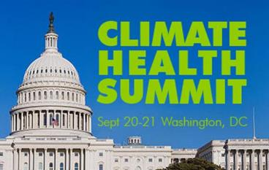

Lynn Ringenberg, MD, FAAP
PSR, President
Professor Pediatrics
University of South Florida
Tampa, FL
Climate Change & Waterborne Disease
~ I have no financial disclosures ~
Notes:
Weather and climate change play a significant role in our health and well-being. I’m going to discuss some health issues related to waterborne infectious disease.
There are an estimated 12-19 million outbreaks of endemic waterborne disease annually in the US., with many of the infectious agents not identified….so probably a much bigger problem.

Slide 2
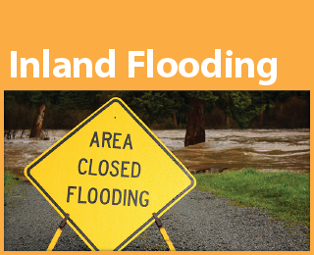
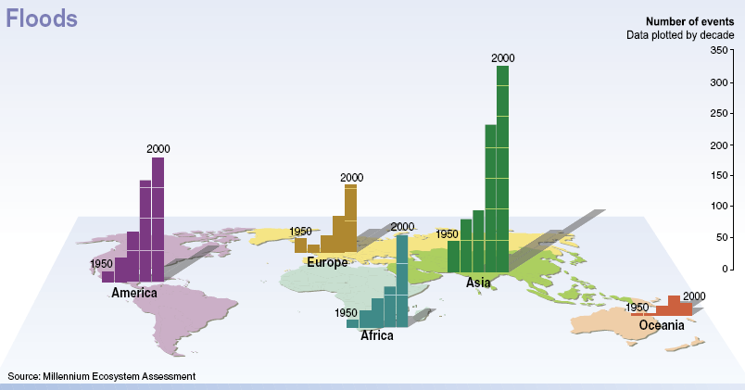
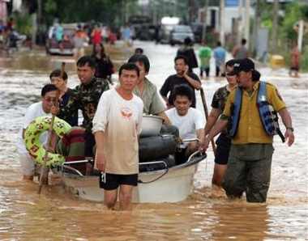
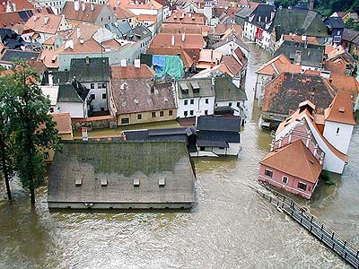
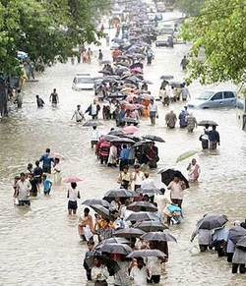
Flooding & Storm Surge
Globally, over 1 billion people lack access to safe drinking water
2.5 billion lack access to adequate sanitation
Estimated that 5 million people globally, primarily kids, die from water-related diseases annually
Notes:
As global warming continues to shrink water supplies in already water-stress regions of the world and populations become increasingly dependent on decreasing sanitary water souces for all their basic needs, the global burden of water-related diseases will increase.

Slide 3
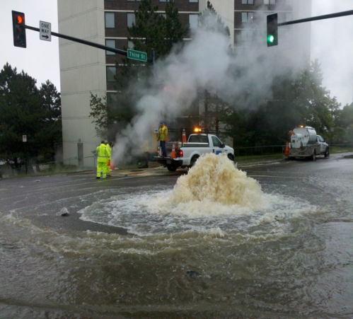
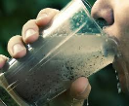
Waterborne Infectious Diseases
Rainfall: transport and dissemination of infectious agents
Flooding: sewage treatment plants overflow; water sources contaminated, secondary shortage of clean drinking water
Sea level rise: enhances risk of severe flooding
Higher temperatures: Increases growth and prolongs survival rates of infectious agents
Drought: increases concentrations of pathogens, impedes hygiene
In North America, most documented waterborne disease outbreaks occur after extreme precipitation events.
9 million cases of waterborne disease occur annually in the U.S.
Foodborne diseases cause 76 million illnesses a year, with 325,000 hospitalized and 5,000 deaths
Bacteria | Parasites | Viruses | Fungus
Vibrio species E. Coli Campylobacter Salmonella Leptospira Legionella | Cryptosporidium Giardia Toxoplasmosis Cyclospora Naegleria | Hep A Polio Norovirus | Cryptococcus Aspergillus Harmful Algae Bloom (HAB)
Notes:
I won’t have time to discuss all these in detail, but focus on the more common.
Aspergillus flavus fungi-produces potent mycotoxins (alfatoxins) from rainfull and warm temperatures contaminate crops---Linked to rainfall and drought. Aflatoxin is a potent human liver carcingogen and synergistically increased the risk of liver cancer in people with Hep B viral infections…with a high prevalence in Africa and Asia.

Slide 4
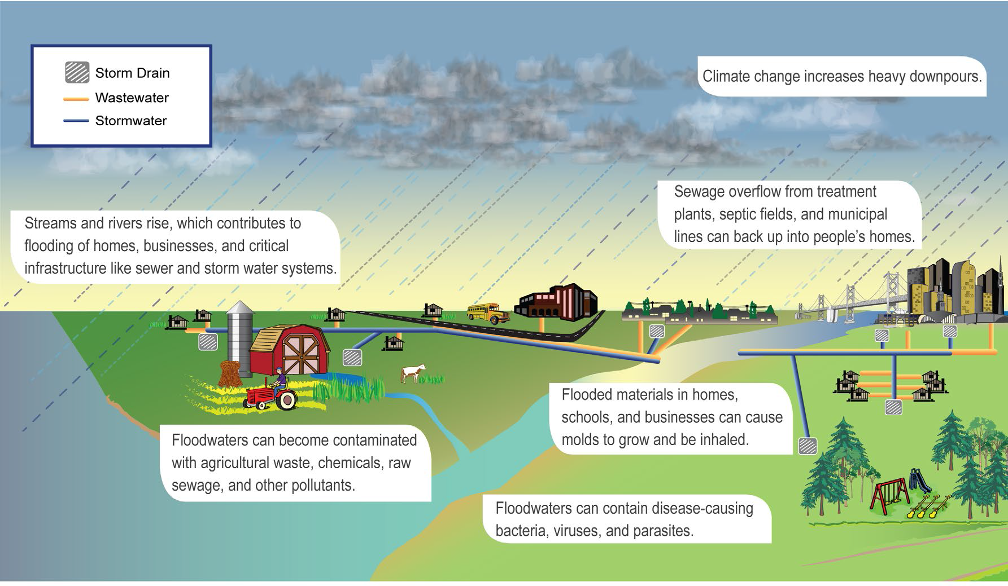
Heavy downpours are Increasing Exposure to Disease
(Figure source: NOAA NCDC/CICS-NC)

Slide 5
Climate Change & Diarrhea
Leading cause of child mortality across the world with ~ 1.6 million annual deaths in children under 5 years of age.
Worldwide, 1.1 billion individuals lack access to improved, safe drinking water sources and 2.5 billion lack improved sanitation.
Children, elderly and those with chronic diseases and weakened immune systems at greatest risk
Studies in India, Peru and China found a 1°Celsius rise in ambient temperature increased diarrheal disease anywhere from 5.6%-16% and found hospital admissions from diarrhea in children increased 8% in Lima, Peru during El Nino period.
Waterborne disease outbreaks in the U.S. exhibit a positive correlation with excess precipitation events
In the U.S by 2100, the Great Lakes climate modeling projects a 50% to 120% increase in overflow events
An analysis of 87 waterborne disease outbreaks from 1910-2010 showed that heavy rainfall and flooding is associated with Vibrio and Leptospira infections most often.
Notes:
The World Health Organization says diarrheal disease, the second most common cause of death worldwide in children under five years old, is both preventable and treatable. It mainly affects children under two years old, and is a leading cause of malnutrition in under-fives.

Slide 6
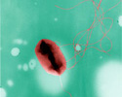
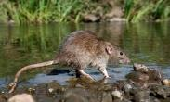
Bacterial Contamination
Toxigenic E. Coli (O157:H7) from contaminated food and water
Bloody diarrhea, vomiting-may lead to kidney failure and even death
Campylobacter-common cause of food poisoning from meats/unpasteurized dairy products/contaminated water.
Salmonella-common cause of food poisoning
Leptospira-spread through the urine of infected animals, rodents, through the soil and water, and during flooding. Infections in urban kids increasing.
Higher temperatures are associated with higher rates of production and disease.
Notes:
HUS…

Slide 7
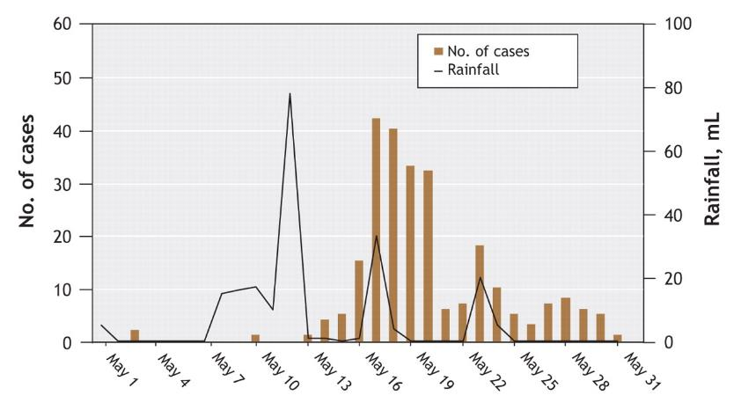
Association between precipitation and waterborne disease outbreaks/Toxigenic E. Coli
Amy Greer, PhD et al. CMAJ 2008;178:715-722
Notes:
Figure 3: Association between precipitation and water-borne disease outbreaks. The graph shows the relation between unusually heavy rainfall and the number of confirmed cases of verotoxigenic Escherichia coli infection that occurred during a massive enteric disease outbreak in Walkerton, Ontario, in May 2000. The incubation period for verotoxigenic E. coli is usually 3–4 days, which is consistent with the lag between extreme precipitation events and surges in the number of cases. 2,300 people became ill with 7 deaths from E. Coli O157:H7 and Campylobacter.

Slide 8
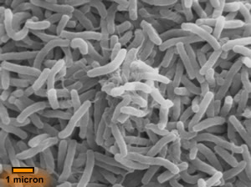
Bacteria: Vibrio Species & Legionella
Vibrio is strongly influenced by climate-both fresh and marine waters
V. Cholera causes estimated 3-5 million cases and 100,000-120,000 deaths yearly world-wide. Young children in endemic areas most affected.
Virulent V. parahaemolyticus strain found in Maryland shellfish & Alaskan oysters in Price William Sound (furthest north) -big public health concern.
Climate warming can increase pathogen development and survival rates, disease transmission and host vulnerability.
Legionella (Legionnaire’s Disease)-respiratory illness transmitted solely by water. Warm water and perhaps other factors, like association with amoebas, influence the potential to colonize water systems.
Notes:
Cell. Infect. Microbiol., 02 January 2014 | http://dx.doi.org/10.3389/fcimb.2013.00110

Slide 9
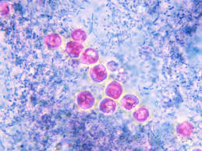
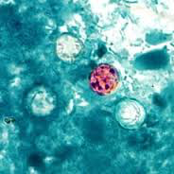
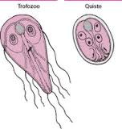
Parasitic Disease
Cryptosporidium-2,000-3,000 cases annually in the U.S.- through livestock waste & contaminated water
Cryptosporidium oocytes detected in 65% to 97% of surface waters tested in the U.S.
Common disinfectants, like chlorination is ineffective
1993 outbreak in Milwaukee was the largest outbreak ever documented in the U.S. with 400,000 cases and 100 deaths.
In 1997, 2,566 cases were reported from 45 states
Giardia lamblia-second most common parasite in the U.S.
Cyst found in raw surface water from animal and human feces
39% of filtered drinking water found Giardia (17%) and Crypto (27%)
Cyclospora-often associated with fresh produce from contaminated water-Big outbreak in 2013 from salad bar/cilantro in TX, NE and IA.
Notes:
Environ Health Perspect. 2001 May; 109(Suppl 2): 211–221.

Slide 10
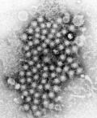
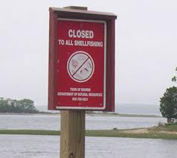

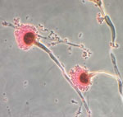
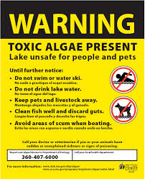
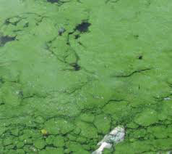
Viral, Fungal & HAB Diseases
Viruses are heat resistant and likely to survive sewer treatment processes. Viruses found in shellfish contaminated with wastewater and fecal sources.
  Hepatitis A
  Norovirus
  Norwalk virus
Fugal Diseases
  Cryptococcus
  Aspergillus
Harmful Algae Blooms (HAB)
Notes:
Aspergillus flavus fungi-produces potent mycotoxins (alfatoxins) from rainfull and warm temperatures contaminate crops---Linked to rainfall and drought. Aflatoxin is a potent human liver carcingogen and synergistically increased the risk of liver cancer in people with Hep B viral infections…with a high prevalence in Africa and Asia.

Slide 11
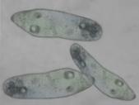
Naegleria fowleri….“Brain-Eating Amoeba”
Notes:
CDC refers to this amoeba as “heat loving”.
A parasite that likes warm waters. First case in Minnesota didn’t happen until 2010. Between 2005 and 2014, 35 people were infected in the US per the CDC
Treatment-Amphotericin directly into the spinal fluid…must be thought of very early and treated aggressively to survive: 3 out of 133 have survived between 1962-2014.

Slide 12


Phillip
Fifth grader-swam in popular lake in central Florida
5 nights later: headache without fever-no stiff neck
24 hours later he was hallucinating
12 hours he was seizing and the next 12 hours he was febrile in septic shock and died
Autopsy revealed trophazoites in the brain, heart, spleen and lungs.
Prevention
Wear nose clips or keep head above water in warm fresh water lakes, rivers, under-chlorinated pools/spas/baby pools
Don’t force water up your nose-like on slip-slides, outdoor hoses
Never use a neti pot or nasal wash with un-boiled tap water
Get a good environmental and play history
Think Amoeba with warm water exposure-over 80° F
Notes:
Phillip loved science and nature….he was aware the the world was changing and wanted to help make it better…he was 10.

Slide 13
Prevention: Waterborne Disease
Improve quality and quantity of drinking at source, at the tap, or in the storage vessel.
Interrupt routes of transmission by empting accumulated water sources
Chlorinate water
Change hygiene behavior, like hand washing
Breastfeeding first 6 months of life
Proper use of latrines
Careful disposal of all waste products
Proper maintenance of water supply, sanitation systems, pumps and wells
Good food hygiene-wash before eating, protect from flies
Improved immunizations practices, especially rotavirus
Develop or enhance public health surveillance system
Faster responses to emergent and dangerous pandemic strains of pathogenic infections.
Health education programs across the country

Slide 14
References:
CDC.gov
EPA.gov: Climate Change in the U.S.: Benefits of Global Action-2015
Climate Change and Public Health: Barry Levy & Jonathan Patz, 2015
Environmental Health Perspectives-Vol 109-May 2001
Climate Change Challenges and Opportunities for Global Health-JAMA-2014
Water-related Disease and Climate-Yale University-2015
Global Climate Change and Children’s Health-Pediatrics-Nov 2007
Lancet Commissions Report: Managing the health effects of climate change-2009
Lancet Commissions Report: Heath and climate change: policy responses to protect public health-2015
National Climate Assessmnt, 2014-globalchange.gov
Cell. Infect. Microbiol., 02 January 2014 | http://dx.doi.org/10.3389/fcimb.2013.00110

Slide 15


Slide 16
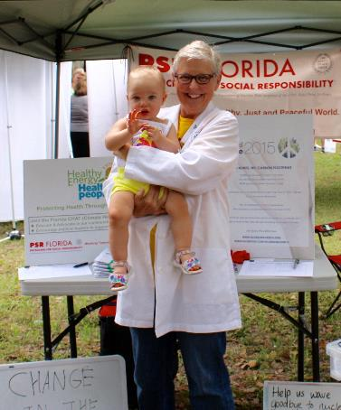

33%
100%
Thank you…Please join us today!
Notes:
This is why we do this work….for our kids, grandkids and for the children of the world. Yes, they are currently 33% of the population, but they are 100% of the future.
As HP…..I believe we have a professional and moral obligation to speak out on any issue that damage our patients health….many of us took an oath…..

