Slide 1
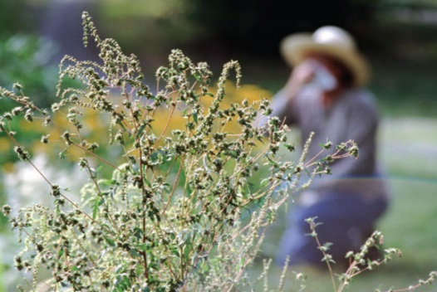
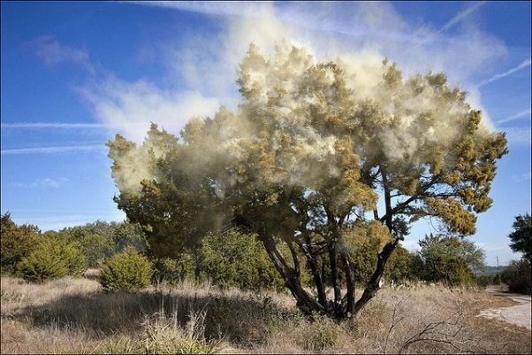
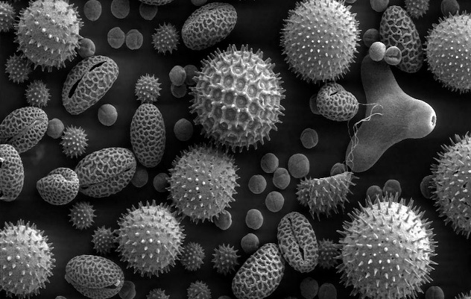
Global Pollen Trends:
Effects of Temperature and Precipitation
and Implications for Human Health
Paul J. Schramm¹; Brown, C.²; Saha, S.¹; Manangan, A.¹; Conlon, K.¹; Bell, J.³, Gerber, K.⁴; Atalla, L.⁵; Hess, J.J.⁶
¹Climate and Health Program, Division of Environmental Hazards and Health Effects, National Center for Environmental Health, Centers for Disease Control and Prevention
²Karna, LLC for Climate and Health Program, Division of Environmental Hazards and Health Effects, National Center for Environmental Health, Centers for Disease Control and Prevention
³NOAA National Climatic Data Center and Cooperative Institute for Climate and Satellites, North Carolina State University
⁴Calvin College
⁵Emory University
⁶Division of Emergency Medicine, Department of Medicine, University of Washington School of Medicine
National Center for Environmental Health
Division of Environmental Hazards and Health Effects

Slide 2
Presenter Disclosures
No relationships to disclose

Slide 3
Background
Pollen affects health
30 – 60 million Americans with Allergic Rhinitis¹
$11 billion per year spent on treatment²
Asthma³, chronic obstructive pulmonary disease⁴, and respiratory tract infections⁴ can be caused or exacerbated by pollen inhalation
Increasing evidence of changes in pollen production
Key question: How are shifts in temperature and precipitation affecting pollen production?
¹Wallace et al, 2008; ²Blaiss et al, 2010; ³Cicera et al, 2012; ⁴Hanigan and Johnston, 2007

Slide 4
Methods – Literature Review
Peer-reviewed published research tracking pollen counts over time
Through January 31, 2016 (currently updating through October 2017)
Environmental Science Collection, Scopus, and CAB Abstracts databases
Title or abstract contained:
a pollen-related term adjacent (within three words) to a measurement/trend term
a term relating to seasonality, climate, or temperature
Pollen terms | Measurement terms | Seasonal terms
Pollen, aero-allerg*, aeroallerg* | Quantit*, producti*, increase*, release*, amount*, concentration*, elevat*, measure*, detection, trend*, count*, change*, variation*, data, cubic meter*, cubic metre*, scale, level*, index, indices , grains, records | Season*, Phenolog*, Spring, Autumn, Fall, flowering, start, peak, onset, temperature*, climate, aerobiolog*, forecast*, pattern*
Notes:
Search was intended to capture research that tracked pollen over time and related it to a meteorological variable or trend.

Slide 5
Parameters for Study Inclusion
Study length: At least 5 years of measured pollen data
Pollen: Airborne pollen measurements
Trends: Analyze or report the presence or absence of a trend in seasonality (length, start, end, or peak pollen date) or intensity (total annual pollen, daily concentration, or peak concentration)
Meteorological Data: Analyze or report relationship between pollen and locally/regionally relevant meteorological data
Reporting: Quantitative pollen or trend data

Slide 6
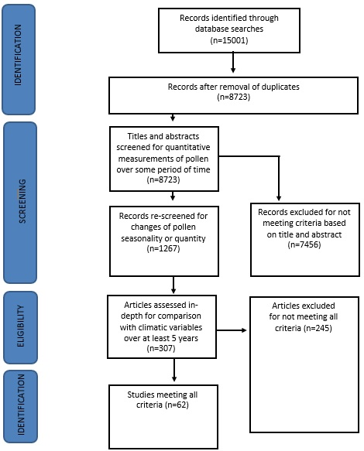
8723 articles identified
307 screened in-depth
62 included
Notes:
PRISMA outline of search process and identification of articles.

Slide 7
Results
 | Number of Analyses
Season start date | 191
Season end date | 112
Peak pollen date | 73
Season length | 161
Total annual pollen | 1499
Mean daily pollen | 35
Peak day pollen | 71
Notes:
“analysis” is a specific pollen measurement in a specific location.
For example: season start date for oak pollen at a site in the USA, total annual tree pollen at a site in Europe.
We use “analysis” instead of “study” because one manuscript often contains multiple analyses (multiple types of pollen, multiple sites, and/or examination of multiple effects).

Slide 8
Study Site Locations
Notes:
Location of each analysis. Each dot may represent more than one analysis.
Europe is over-represented. USA second most representation.
Study is not representative of the Southern Hemisphere.

Slide 9
Shifts in Pollen Timing (% of analyses)
Notes:
Results for shifts in pollen timing:
-Mostly earlier start date
-Later end date
-Earlier peak date

Slide 10
Shifts in Pollen Amount (% of analyses)
Notes:
Shifts in pollen amount:
-More total annual pollen
-More mean daily pollen
-More peak day pollen

Slide 11
Oak pollen and higher temperatures
+
*
*Mean Daily Pollen [Study with 14 sites reported average positive association]
+Annual Pollen [Study with 97 sites reported significant positive association between mean temperature Jan-April and annual oak pollen count]
Notes:
Temperature measured medium-term (current seasonal or annual average, or previous season).
-Start date is earlier
-Annual amount is greater
-Mean daily amount is greater
Also analyzed affect of temperature on oak season length, peak date, end date, and peak day amount.

Slide 12
Ragweed pollen and higher temperatures
*
*Annual Pollen [Study with 97 sites reported significant positive association between mean temperature and annual ragweed pollen count]
Notes:
Higher temperatures resulted in:
-Longer season length
-Greater average daily ragweed pollen count (but only 4 studies)

Slide 13
Summary
For both oak and ragweed, association between increasing temperatures and:
earlier start dates
greater mean daily pollen
greater total annual pollen
Meta-analysis is exceedingly difficult
Need for consistent data; National pollen monitoring network (CSTE/CDC)
Notes:
Meta-analysis is difficult because studies are very different. They measure different types of pollen in different areas over different time periods. They classify meteorological variables in different ways and different timeframes. They report results in different formats, sometimes only reporting averages and not always reporting significance.

Slide 14
Next Steps
Update with 2017 data
Analysis of geographic variation
Analysis of impact of precipitation
Statistical analysis of impacts of temperature and precipitation on pollen production

Slide 15
Climate and Health Program Division of Environmental Hazards & Health Effects National Center for Environmental Health Centers for Disease Control and Prevention Email: pschramm@cdc.gov climateandhealth@cdc.gov Website: http://www.cdc.gov/climateandhealth/
For more information please contact the Centers for Disease Control and Prevention
1600 Clifton Road NE, Atlanta, GA 30333
Telephone: 1-800-CDC-INFO (232-4636)/TTY: 1-888-232-6348
E-mail: cdcinfo@cdc.gov Web: http://www.cdc.gov
The findings and conclusions in this report are those of the authors and do not necessarily represent the official position of the Centers for Disease Control and Prevention.
National Center for Environmental Health
Division of Environmental Hazards and Health Effects
Notes:
Thanks very much.

